Slide 1














CODE APEX
THE END IS COMING.
Team Details
Team name - Byte Flash
Team leader Name - Om Avinash Watane
Problem Statement (Domain) - Open Innovation

Slide 2



Problem Statement & Target Need
Who is affected
1. Chief Information Security Officers of banks, Security Operations Center analysts, and teams that handle information technology compliance and risk.
2. Credit institutions and banks supervising by National RBI and CERT-In.
3. In the end, the customers relying on their funds and information being effectively safeguarded.
The current gap
1. Financial institutions operate more than 20 different security tools (including firewalls, scanners, EDRs) which are incompatible with each other
2. Threats are categorized only as “High / Medium / Low”, without any financial value
3. Incident correlations as well as reports from CERT-In or RBI are prepared manually in Excel.
4. As a consequence, this leads to slow reaction, uncertain reports, and budget decisions taken based on intuition
Why it matters now
1. Cyber incidents should be reported within 6 hours according to CERT-In and rapid reporting is also required by RBI.
2. Digital banking and UPI continue to see growth, and with this increase, the attack surface is expanding constantly.
3. Now, boards as well as regulators want to know “what is our financial exposure” and not only “are we safe?”
4. If the deadlines are missed, there are penalties, audit results, and erosion of trust from customers.
5. RBI’s 2026 Cybersecurity Directions make banks answerable for vendor security: written proof that software is free of known vulnerabilities and malware, renewed after every material change, plus source-code or escrow access

Slide 3

Proposed Solution & Innovation
What makes it different
1. It does not substitute the tools that are already in place. Its purpose is to link all the tools together into one cogitative center, the brain.
2. It also uses Open FAIR to assess the threats in monetary terms.
3. It makes use of the tools to calculate the least expensive way to save the greatest amount of money.
4. It was designed specifically for India.
Core mechanism
RBI Notification
1. Webhooks take in the feed of live data from scanners, firewalls, and EDR and crystallizes it into one standardized schema
2. Monte Carlo simulation (Open FAIR) evaluates the expected financial loss per threat
3. MILP solver searches for optimal fixes within the limitations of the bank's finance
4. Async queue (Redis + Celery) sends out notifications on Slack or by email as soon as the risk threshold is breached
5. Generates compliance reports automatically within the 6-hour requirement
https://rbi.org.in/scripts/NotificationUser.aspx?Id=13643&Mode=0
Why it's feasible in this timeframe
Report on vendor complience done by RBI is as per the latest rules passed by them. CyberQ provides all the required technology to bank for complience purposes as mandated by RBI
1. Tested, open-source stack: FastAPI, Celery, Redis, PuLP / OR-Tools, PostgreSQL
2. Simulator script simulates alerts from 3 different tools, eliminating reliance on actual integrations
3. One seamless end-to-end process: alert → risk amount in rupees → optimizer → notification → PDF
4. Verified by actual input from IT manager of a reputed public sector bank.

Slide 4

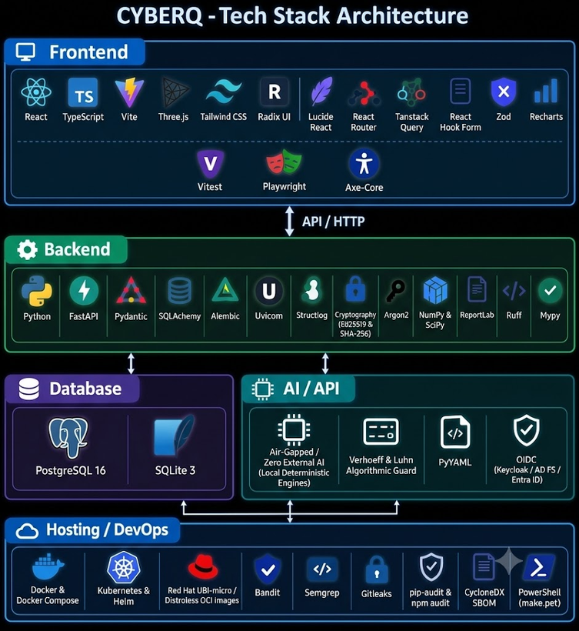
System Architecture & Tech Stack
TECH STACK
System Architecture
Bank Security Tools
Web Console
Frontend
SIEM
Intake Adapters
PII gaurd
(redacts aadhar and PAN card numbers)
Command Center
EDR
Incident Service (State Machine)
Clock Engine
Obligation Packs (CERT-in, RBI, DPDP)
Deadline Corridor
Filing Packets
backend
VULNERABILITY SCANNER
Applicability Check (Compliance Approval)
Filling Packet (maker-checker)
Decision Ledger
Decision Ledger
CLOUD SOC ALERTS
Worker (Durable Timers, Escalations)
Notification Outbox
Audit Chain (Hash-Linked, Signed Checkpoints)
Shift Handover
Database
Exposure Engine and Model Governance
Bank Services
AI / APIs
Identity Provider
Compliance Approver
RBI Daksh Portal
PostgreSQL
HSM / Key Service
SOC Analyst
CERT-In Portal
SOC Wallboard
(Read - Onlu)
Email Re;ay SMTP
Chat / Webhook
Hosting / DevOps
Dedicated Role
Shift Handover

Slide 5
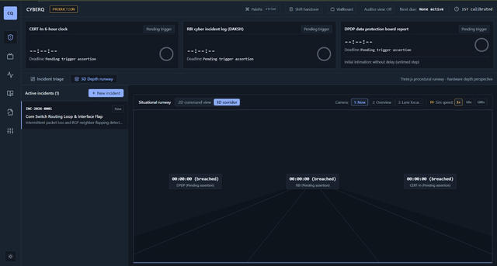
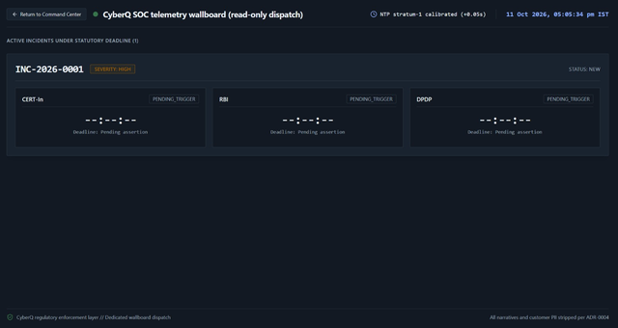
Key Features & UI/UX
ui /ux
1. Centralized security dashboard:
The dashboard offers a birds-eye view of security incidents, financial exposure, connected tools and critical alerts.
2. Visual risk analytics:
It displays information on financial losses, risk trends and threat severity as charts or graphs using intuitive colors.
3. Interactive incident management:
Users can search, filter, prioritize and investigate incidents in detail with an in-depth view of the events.
Key Features
1. Unified Security Integration:
Unified cybersecurity solutions through APIs and webhooks to consolidate the security events of various tools on a common platform.
2. Financial Cyber Risk Quantification:
Financial impact estimation of the cyber risk using open FAIR-inspired models and optimized the allocated security budget using mixed-integer linear programming.
3. Real-Time Risk Alerts:
Setting financial thresholds for triaging the risk in case of an incident thus enabling faster response to the most critical incidents
4. Automated Compliance Reporting:
Generated standardized PDF reports of the incident to ease the auditing process for the relevant RBI and CERT-In regulations.

Slide 6
Implementation Roadmap & Scope
What's built today, what's in progress, and what's planned beyond the hackathon
ROADMAP OF IMPLEMENTATION
1) Data Ingestion : A FastAPI program implemented in Python is used for the creation of simulated security alerts.
2) Financial Risk Analysis : Risk assessment modeled on Open FAIR is executed using NumPy.
3) Budget Optimization : Process of remediation is based on PuLP algorithm which complies with the budget.
4) Alerts & Reporting : Risk alerts and drafts of compliance reports based on evidences are created.
5) Dashboard & Testing : The application implements React dashboard for risk visualization and testing.
SCOPE OF PROJECT
  Consolidated overview of SIEM, EDR, and vulnerabilities notifications.
  Identification of financial exposure and ordered remediation action.
  Security suggestions following budget constraints.
  Role-based access management and audit tracking.
  Templates of compliance reports for authorized verification.

Slide 7
Expected Impact & Scalability
Who benefits, how big the opportunity is, and how this grows beyond a demo.
EXPECTED IMPACT
SCALABILITY
Banks and Financial Organizations:
  Common visibility into cybersecurity threats.
  Quick identification and classification of critical weaknesses.
  Enhanced allocation of security budget using risk-based recommendations.
  Easier way to compile evidence-supported compliance documents.
Security Teams:
  Less manual work in the review of alerts.
  More clear information about risks to allow for smart decision-making.
  Consequently, improved work among security systems.
Stage 1) Prototype Hackathon:
Simulated security information, risk evaluation, and user-friendly dashboard.
Stage 2) Pilot Implementation:
Connect selected security tools, and execute them through recognized test environments.
Stage 3) Organization Level:
Cloud-based deployment, expansion of data pipeline, complicated threat association systems, and multi-bank capability.
Long-term vision:
Shape CYBERQ into a centralized cyber intelligence platform geared towards financial institutions.
Key value: Better visibility; smarter prioritization and budget control.

Slide 8





CODE APEX
BUILD BEFORE IT DOES.
POWERED BY
THANK YOU

